Slide 1
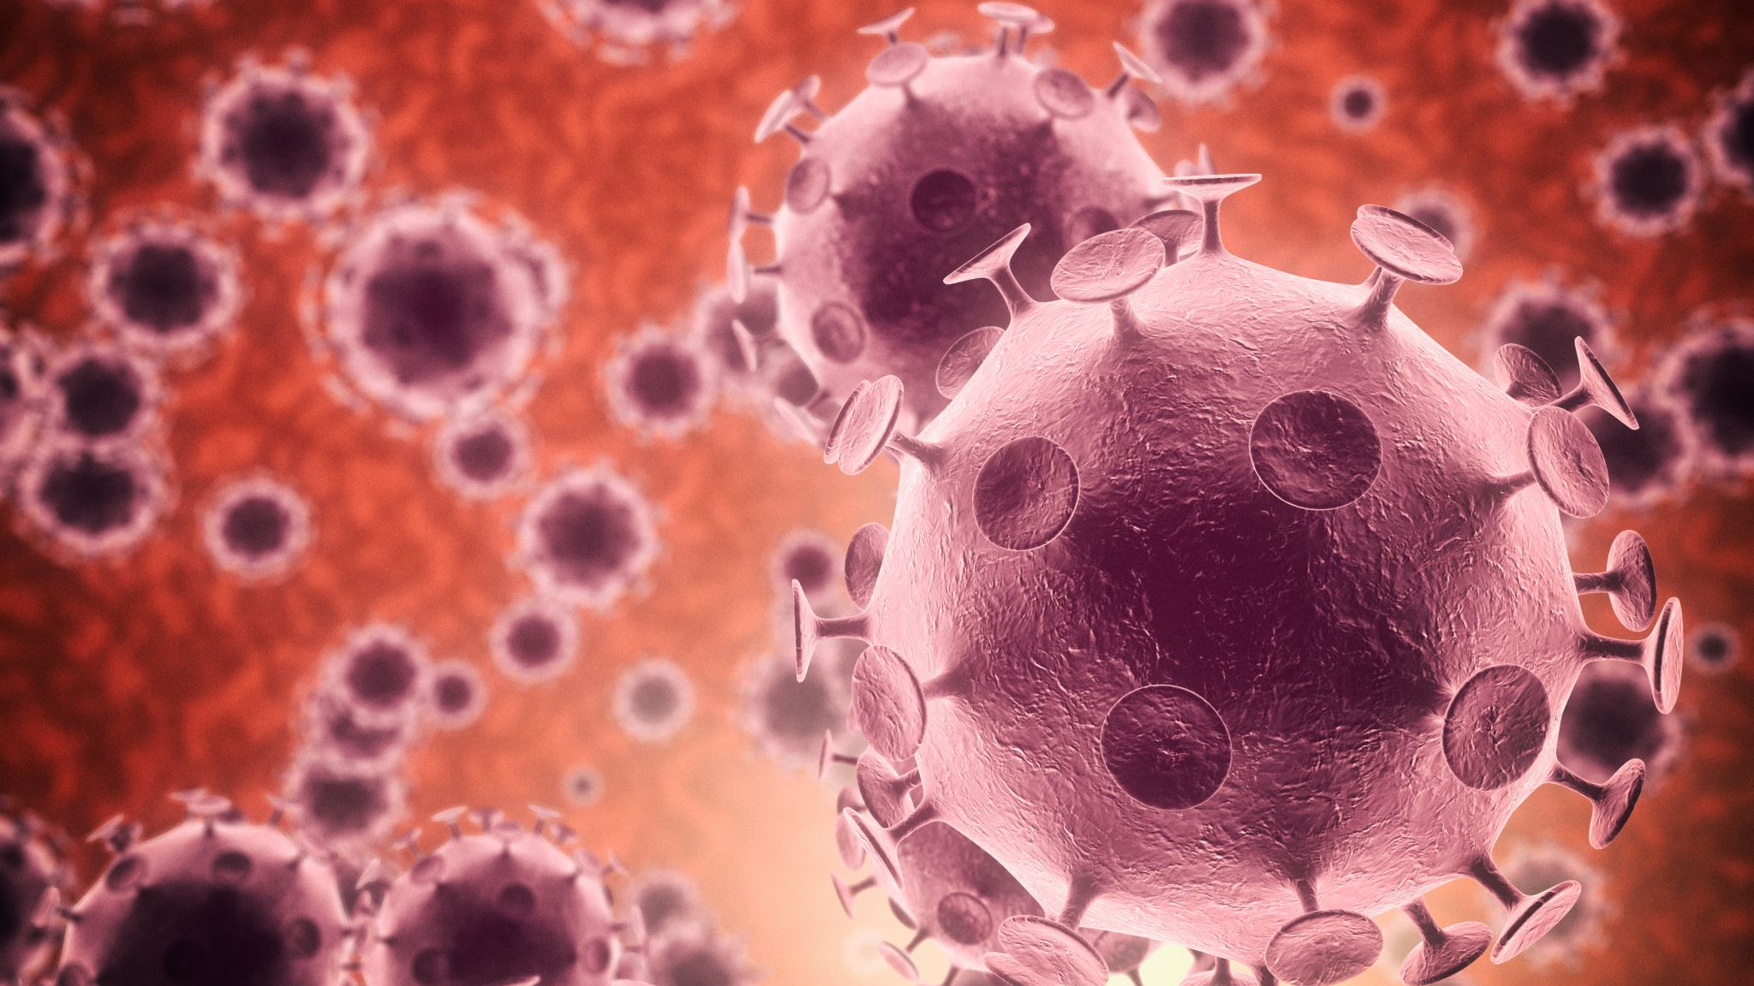
Viral Pathogens and Viral Diseases
Updated by Ms Rayner 2022

Slide 2
Pathogens Life Cycle

Slide 3
Recap: Define the term pathogen and state the four groups of pathogens that can cause disease

Slide 4
Topic Question 1: Describe the main features of a pathogens life cycle
This cycle is known as a pathogen’s life cycle. Some pathogens have developed elaborate life cycles that enable them to survive, reproduce and spread.
Infected host reservoir
Site for replication of infectious agent
Portal of exit
Some infectious diseases have another possible reservoir
Mode of transmission
Portal of entry
Susceptible host

Slide 5
Topic Question 2: State the ways pathogens can leave a hosts body and how they can enter a susceptible hosts body
Portals of entry | Portals of exit
•Skin (bite, blood feed, penetration) •Mucous membranes •Wounds in epidermal layers of animals and plants •Eyes and ears •Respiratory system/nose/throat/lungs | •Bite/blood feed/saliva •Digestion (elimination) •Respiratory system (coughing, sneezing) •Blood contact •Reproductive system (some honeybee viruses pass from queen bee to worker bees)
Biology WA Units 3 & 4
Set 13.1 pg.432 Q 1-5

Slide 6
Recap: Define the term transmission and the two modes of transmission
Transmission is how the pathogen is transferred from the host and/or a reservoir to a susceptible host, which can involve developmental stages occurring in the
environment or in vectors.
Vectors are living or non-living things that transport pathogens from the
infected host to a susceptible host. Mosquito vectors transport pathogens through blood feeds. Bat vectors transport pathogens through bites and scratches.
The different modes of transmission are commonly classified as direct or indirect. Direct transmission is the transfer of a pathogen from an infected host, or other reservoir, to a susceptible host by direct contact or droplet spread.
Indirect transmission is the transfer of a pathogen from a reservoir to a host through vectors (inanimate vehicles as well as living intermediaries) or suspended air particles.

Slide 7
Recap: Describe the different ways diseases can be transmitted by direct transmission
Direct transmission
Direct contact
Transmission due to physical touch between an infected host and a susceptible host via skin/body fluids
ABL via infected bat
Influenza
Close contact
Transmission of pathogen in airborne droplets between an infected host and a susceptible host, such as sneezing/coughing within 1 metre or due
to close proximity
Influenza
Reservoir (other)
Transmission from an inanimate reservoir/fomite to a susceptible host. A reservoir could be soil, as for tetanus bacteria.
Tetanus
Influenza (fomite)

Slide 8
Recap: Describe the different ways diseases can be transmitted by indirect transmission
Vectors are living or non-living things that transport pathogens from the infected host to a susceptible host. Mosquito vectors transport pathogens through blood feeds. Bat vectors transport pathogens through bites and scratches.
Indirect transmission
Vector
A living thing that transmits a pathogen from an infected host to a susceptible host. Bats and mosquitoes are vectors.
Tetanus via dog-bite saliva
Honeybee viruses via varroa mite
ABL via healthy carrier bat
Ross River disease
Malaria

Slide 9
Recap: Describe the different ways diseases can be transmitted by indirect transmission
Indirect transmission
Soilborne/ waterborne/foodborne and vehicle or fomite
An inanimate object (fomite) acts as an intermediary between the portal of exit from the reservoir and the portal of entry to the host. For example, car tyres and human shoes can carry pathogens from a contaminated area to an area containing susceptible hosts.
Pathogens can swim or be carried through water or wet soil from an infected host to a susceptible host.
Contaminated food (note none of the diseases studies are transmitted this way)
Crown gall can enter via a wound
Chytridiomycosis
Phytophthora
Biology WA Units 3 & 4
Set 13.2 pg.432 Q 1-5

Slide 10
Recap: State the pathogens that cause the 10 diseases
Pathogen classification | Diseases
Virus | Influenza | Ross River disease/fever | Viral diseases of honeybees | Australian bat lyssavirus
Bacteria | Tuberculosis (TB) | Tetanus | Crown gall of plants
Fungus | Chytridiomycosis (amphibian chytrid fungus disease) (caused by fungi)
Protist | Malaria | Phytophthora dieback (jarrah dieback)*
*The Phylum Oomycota containing Phytophthora dieback has been removed
from the Fungi Kingdom and placed in the Protista Kingdom

Slide 11
Pathogen - Viruses

Slide 12
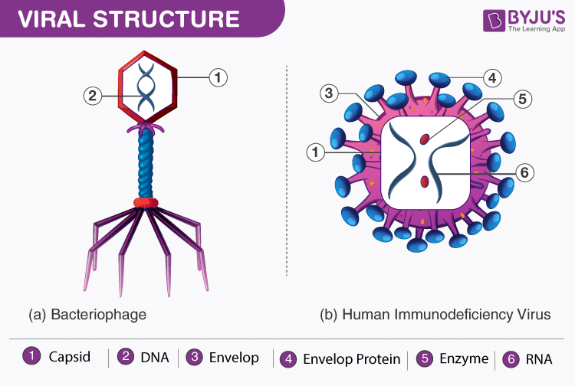
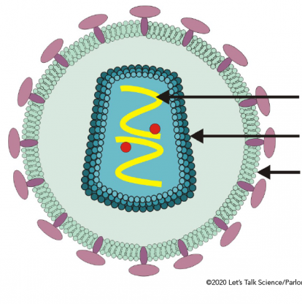
Topic Question 3: Label the bacteriophage and the enveloped virus
1.
2.
3.

Slide 13
Topic Question 3: Label the bacteriophage and the enveloped virus
1.
2.
3.

Slide 14
Topic Question 4: List structural features of viruses
Virus structural features
DNA or RNA enclosed within a capsid or protein coat
Nucleic acid, either DNA or RNA
No organelles, no metabolic machinery, metabolically inert
Very small. 30 - 300 nanometres in length
have proteins that can recognise and bind to receptors on host cell

Slide 15
Topic Question 5: Explain why a virus can be described as a non-cellular pathogen
Viruses are non-cellular pathogens.
Viruses consist of one or more strands of nucleic acid (RNA or DNA) inside a protein coat.
They maintain this structure during the inert phase of their life cycle; that is, when they are not inside a host.
Viruses are NOT made out of cells and therefore are non-living.
They possess no metabolic machinery for processes such as cellular respiration.
Viruses cannot be classified as prokaryotes or eukaryotes, because they are non-cellular.
Instead of cellular features such as ribosomes and mitochondria, they have some nucleic acid and a protective coat.

Slide 16
Topic Question 6: Describe why a pathogen can be said to be an obligate parasite
A virus is often referred to as an obligate parasite
An obligate parasite is an organism that can only survive inside another organism
A virus does not have any metabolic machinery, it is metabolically inert. Meaning it can not grow or reproduce outside of a host cell, therefore a virus must enter a cell to perform these processes

Slide 17
Topic Question 7: Using a clearly labelled diagram describe how an enveloped virus replicates within a host eukaryotic cell

Slide 18
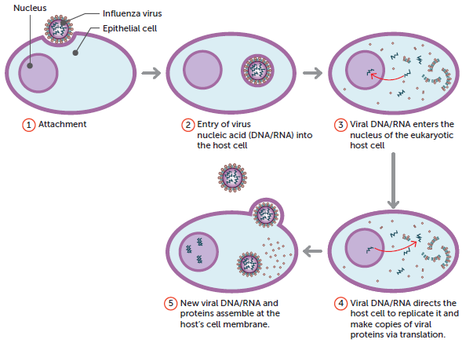
Topic Question 7: Using a clearly labelled diagram describe how an enveloped virus replicates within a host eukaryotic cell

Slide 19
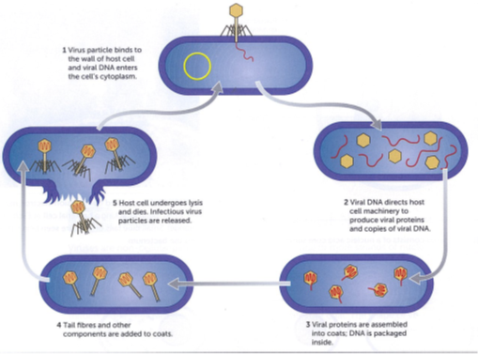
Topic Question 7: Using a clearly labelled diagram describe how a bacteriophage replicates within a host bacterial cell
Biology WA Units 3 & 4
Set 12.2 pg.413 Q 1-8

Slide 20
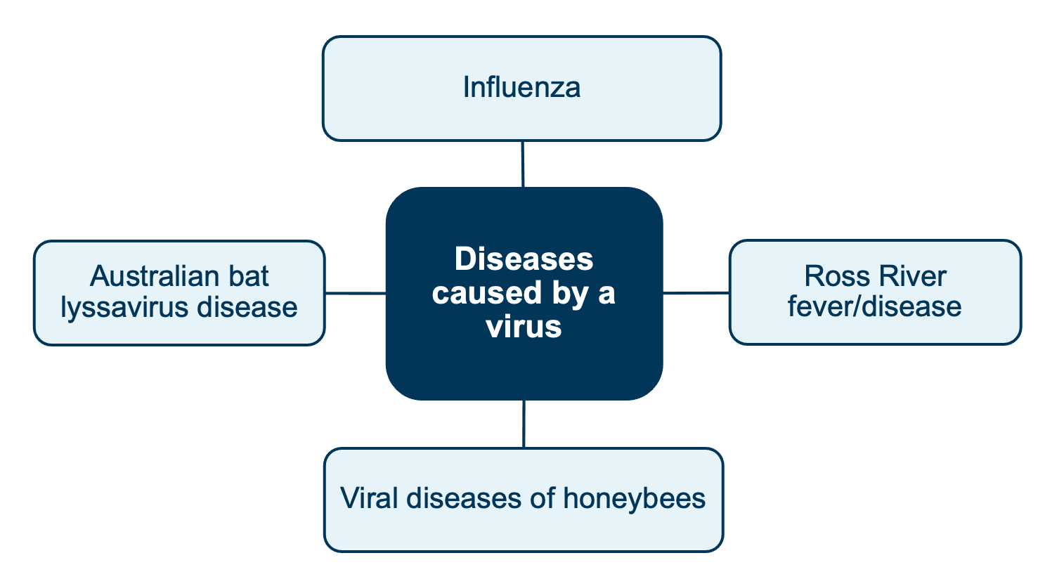
Examples of diseases caused by a virus

Slide 21
Viral disease example:
Ross River disease is also known as Ross River fever. Symptoms of the disease include a rash on the limbs or trunk for 5–10 days; painful and swollen joints, usually lasting for months; fever and headache.
The primary replication of the virus occurs in skeletal muscle cells before it enters the blood. The virus also replicates in the mosquito vector.
Shutterstock.com/yurakrasil

Slide 22
Viruses - Recap
Small
Contains RNS or DNA
Metabolically inert (no metabolic activity outside of host cell)
Only replicated inside living cells – virus redirects host cell to manufacture viral nucleic acids & proteins to make new virus

Slide 23
Life Cycle - Viruses

Slide 24
Influenza Virus
The infectious agents that cause influenza are the influenza A, B or C viruses.

Slide 25
Influenza Virus Structure
The single-stranded enveloped RNA virus

Slide 26
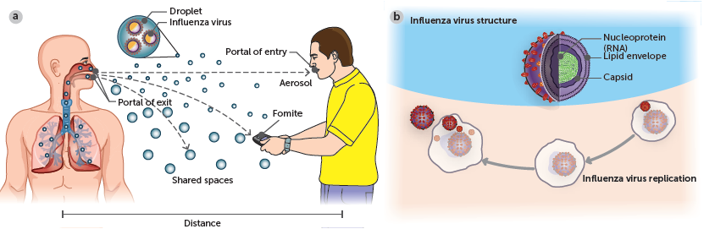
Influenza Life Cycle
Infected host reservoir
Site for replication of infectious agent – Epithelial cells of the Respiratory System
Portal of exit via cough & sneeze releasing influenza virus in airborne droplets
Mode of transmission
1. Air borne droplets (direct transmission via close contact)
2. Direct contact via touch
3. indirect contact via fomites & airborne droplets that have become aerosols
Portal of entry via inhaling airborne droplets containing influenza virus
Susceptible host
Caused by Influenza A, B or C Virus

Slide 27
Influenza life cycle

Slide 28
Influenza Virus Mode of Transmission
The influenza virus is usually transmitted from the respiratory tract, through the air inside airborne droplets, when an infected host coughs or sneezes.
The viruses, found in the airborne droplets/spray, are inhaled by a susceptible host in close proximity
Therefore, the mode of transmission is primarily direct transmission via close contact

Slide 29
Influenza Virus Mode of transmission
After the release of new viruses from the epithelial cells, a cough or sneeze may send a spray of airborne droplets into the air.
The droplets may be inhaled by someone in close proximity or become an aerosol and drift with air currents, to be inhaled at a later time or land on a surface known as a fomite.
Therefore, transmission, although usually direct via close contact, can be indirect via airborne droplets or fomites.

Slide 30
Influenza Modes of Transmission
Direct transmission
Direct contact
Transmission due to physical touch between an infected host and a susceptible host via body fluids on hands after cough or sneeze
Close contact
Transmission of pathogen in airborne droplets between an infected host and a susceptible host, such as sneezing/coughing within 1 metre or due
to close proximity

Slide 31
Influenza Modes of Transmission
Indirect transmission
Airborne droplets
When the airborne droplets (if small enough) become an aerosol & drift with the air currents beyond 1 – 2 meters, to be inhaled at a later time by a susceptible host
Fomite
When airborne droplets containing influenza virus land on an inanimate object making it a fomite

Slide 32
Influenza Virus Mode of transmission
Mode of transmission – Close contact
Spread by close host contact, airborne droplets and touching contaminated surfaces
How quickly the virus spreads via these methods will be influenced by
  Host density
  Host behaviour
Spread will be faster when host density is high because potential hosts come in close contact more often
Spread will be faster if hosts have unhygienic practices
Will spread to new areas if infected hosts move around

Slide 33
Influenza Virus Replication
The viruses will attach to epithelial cells along the respiratory tract
If those cells contain suitable virus receptor cells.
The influenza virus is an RNA-type virus. It will undergo viral replication inside the epithelial cells.
After the release of new viruses from the epithelial cells, a cough or sneeze may send a spray of airborne droplets into the air.

Slide 34
Influenza – Prevention
Vaccination
Hygiene
  Washing hands
  Using hand sanitizer
  Cover cough & sneezes
  Cleaning & sanitizing surfaces
Quarantine
  Isolate when sick while exhibiting symptoms of illness
    Stay away from work, child care, school, mass gatherings
Personal PPE
  Face masks

Slide 35
Influenza – Treatment
Rest
Drink fluids
Paracetamol
Decongestants
Antivirals
Hospitalization

Slide 36
Watch!
https://www.youtube.com/watch?v=WSZEcpti2i0&list=PLsMs3sjjy-pCcR8l3ohnIUhIiCwEjQB6K&index=93
https://www.youtube.com/watch?v=oXzwtGFyBik

Slide 37
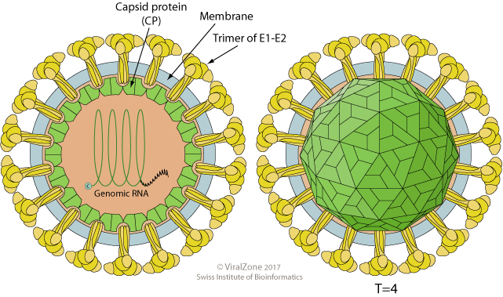
Ross River disease
The infectious agent that causes Ross River disease (also known as Ross River fever) is Ross River. It is a single-stranded RNA enveloped virus.

Slide 38
Ross River disease is endemic
The virus is an Alphavirus and is endemic in Australia, always present at low levels in some populations or regions. Occurs regularly in certain regions (Australia and Papua New Guinea)
Endemic definition The disease is always present within a region or population
Ross River Virus is endemic in the south-west of WA, where outbreaks have been recorded, such as the one in 2017.

Slide 39
Ross River disease
The virus is transmitted indirectly via vectors. These vectors are the female mosquitoes with Alphavirus, usually from marsupials such as wallabies or kangaroos, to humans via blood feeds.
Major mosquito species that can transmit the virus are Aedes vigilax, A. camptorhynchus (saltmashes & coastal areas) and Culex annulirostris
Vector definition
A vector is an agent that transmits pathogens from one host to another
(this is not the same as the definition in genetics)

Slide 40
Ross River disease
Outbreak definition
An outbreak is a sudden, unexpected increase in the prevalence of a particular disease above the baseline level for that population; it could be a single case of a contagious disease in a small community
Outbreaks in Australia have coincided with an increase in rainfall and flooding.
After significant rainfall, the increase in still water bodies increases the potential breeding sites for the mosquito vectors.

Slide 41
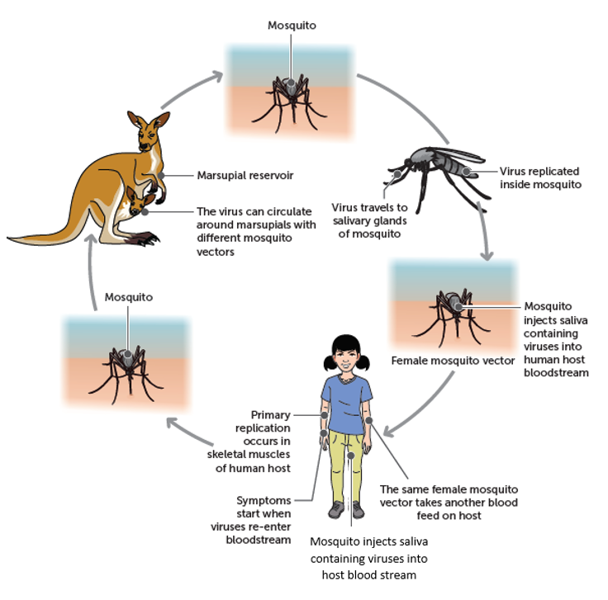
Ross River virus life cycle

Slide 42
Ross River disease
The spread of the disease is influenced by the mode of transmission, via vector (indirect)
Spread influenced by characteristics of the vector
Spread will be faster if vector density/abundance is high because the vector and host will come into contact more often
Can only spread in areas & at times the vector is present

Slide 43
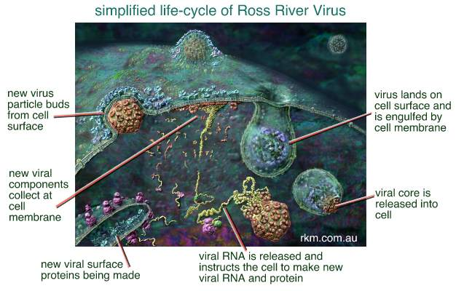
Ross River Virus Replication
RRV replicates within muscle cells
The virus lands on the cell surface & attaches to appropriate receptors on the muscle cells. It is the engulfed by the cell membrane

Slide 44
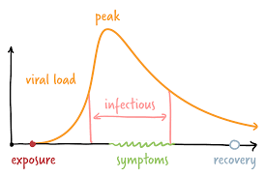
Ross River Virus Incubation period
1 – 3 weeks
The incubation period is the time between infection and the onset of symptoms
Diseases are usually contagious before the onset of symptoms
This means the pathogen can be passed on before the person even knows they have it
May be an adaptation of the pathogen allowing it to be transmitted before the host is incapacitated by symptoms
In the diagram opposite the incubation period is from the time of exposure or infection until the time symptoms are observed. There is an overlap of an infectious period during this time

Slide 45
Ross River Virus Impact on Host & Symptoms
Symptoms
  Rash on limbs for 5 – 10 days
  Painful & swollen joints usually lasting for months
  Fever 7 headache
Impact on Host
      Everyone recovers from the onset of symptoms
      Most people recover completely with 3 – 6 months
      Current knowledge suggests that the body builds an immune response to the virus
      Some people may have symptoms that last longer than 1 year or recur

Slide 46
Ross River Virus Prevention
Protection against mosquito bites
Wear long, loose fitting, light coloured clothing
Use effective mosquito repellents containing picaridin or DEET on all exposed skin.
Try to limit outdoor activity if lots of mosquitoes are about. The hours before and after sunrise and sunset is when most mosquitoes are more active, but some will also bite in the middle of the day.
Sleep under mosquito nets treated with insecticides if you don’t have flywire screens on windows on your home or are sleeping in an untreated tent.
Sleep under a mosquito net if camping out in the open.
Mosquito coils can be effective in small outdoor protected areas..
Avoid mosquito-prone areas, especially at dusk and dawn when mosquitoes are more active and likely to bite.

Slide 47
Ross River Virus Prevention
2. Control Mosquito population
Reduce the number of potential mosquito breeding habitats around your home by ensuring no stagnant water is present. Containers holding water should be emptied and washed regularly.
Use ‘knockdown’ sprays and plug-in vaporising devices indoors.

Slide 48
Ross River Virus Treatment
Treatment is symptomatic, with rest advisable in the acute stages of the disease.
Non-steroidal anti-inflammatory drugs may be prescribed
There is no vaccine currently available commercially to protect against Ross River Virus disease.

Slide 49
Viral diseases of honeybees
There are many infectious agents that cause honeybee diseases, including 24 known honeybee viruses.
Common diseases are sacbrood, black queen bee virus, chronic bee paralysis virus and deformed wing virus.
Viruses may cause diseases that are asymptomatic, or they can be highly virulent and kill the hive.
This significantly reduces the rate of pollination in the areas where the bees had
previously resided, including the pollination of crops, which in turn affects human populations.
Honey bee viruses
https://bee-health.extension.org/honey-bee-viruses-the-deadly-varroa-mite-associates/

Slide 50
Viral diseases of honeybees in Australia
https://www.awe.gov.au/biosecurity-trade/pests-diseases-weeds/bees
https://bee-health.extension.org/honey-bee-viruses-the-deadly-varroa-mite-associates/

Slide 51
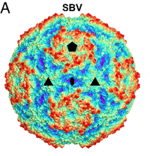
Sacbrood disease
Sacbrood disease is caused by the sacbrood virus in the Ifavirus genus, which has infected bees internationally and was detected in WA in 1979.
Single stranded RNA

Slide 52
Sacbrood disease
This disease mostly affects worker larvae, but can also infect adult honeybees.
Infected larvae die just before pupation. The virus’s mode of transmission may be foodborne: the virus can be carried by vector nurse bees when contaminated food is fed to the brood of larvae.
The virus replicates inside the larvae cells, causing the larvae to display unusual behaviour.
The larvae turn onto their backs and lie stretched out with their heads lifted.
After the larvae die and dry out, millions of viruses surround the dead larvae. When humans clean out dead larvae, they can cause the viruses to be
disturbed and transported to other worker bees.
Sacbrood virus
https://beeaware.org.au/archive-pest/sacbrood/#ad-image-0

Slide 53
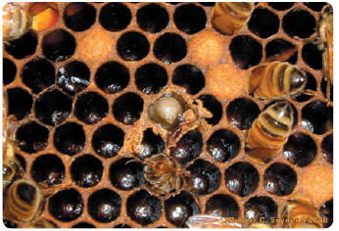
Sacbrood disease
Rob Snyder/Bee Informed Partnership, University of
Maryland (www.beeinformed.org) accessed May 2020.
Read page 438 Biology WA ATAR Units 3 & 4 and use

Slide 54
Other Viruses of Honey Bees
Deformed Wing Virus
    Read page 438 of Biology WA ATAR Units 3 & 4
Black Queen Cell Virus
      https://beeaware.org.au/archive-pest/black-queen-cell-virus/#ad-image-0
      https://www.planthealthaustralia.com.au/wp-content/uploads/2016/02/Black-queen-cell-virus-FS.pdf

Slide 55
Impact and Control of Viral diseases in Honey bees
Visit the websites below to answer the topic questions on controlling varroa mite and viral diseases of Honey Bees in Australia and the impact of disease on the environment
https://beeaware.org.au/archive-pest/varroa-mites/#ad-image-0
https://www.agrifutures.com.au/wp-content/uploads/publications/12-058.pdf
https://www.awe.gov.au/biosecurity-trade/pests-diseases-weeds/bees
https://beehealth.bayer.us/bayer-news-and-resources/newsletters/spring-2016/spring-warning-high-number-of-varroa-infestations-may-affect-this-years-bee-colonies

Slide 56
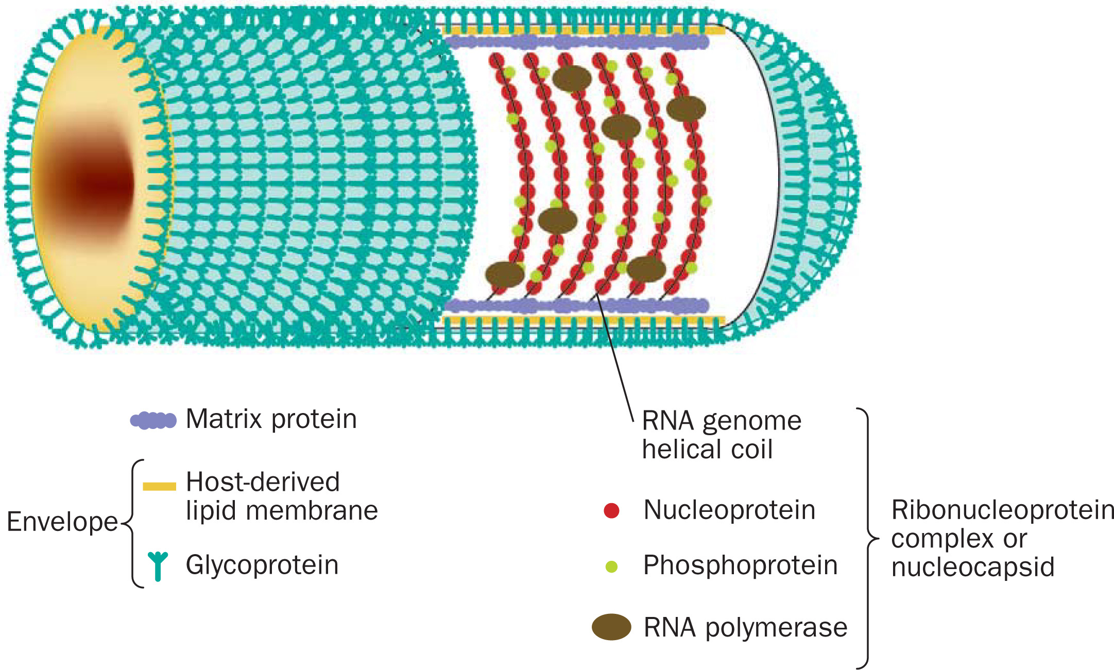
4 Australian bat lyssavirus (ABL) disease

Slide 57
Australian bat lyssavirus (ABL) disease
Australian bat lyssavirus (ABL) disease is caused by the Australian bat lyssavirus.
The virus was discovered in 1966. It is closely related to the rabies virus, but the rabies virus is not found in Australia.
The virus infects Australian flying foxes (fruit bats) and microbats.
The disease can be transmitted from bats to humans, horses and other bats.
It is a Zoonotic disease
© Copyright CSIRO Australia

Slide 58
ABL disease in humans
The disease affects the nervous system in humans, and can cause fatal encephalitis (inflammation of the brain), shown at right below.
Science Photo Library/Living Art Enterprises, LLC/Science Source

Slide 59
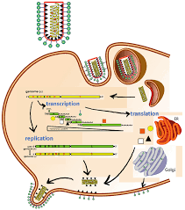
Australian bat lyssavirus life cycle
ABL transmission occurs when infected bat saliva enters human body
Infected reservoir
bat host
Virus replicates within the bat & found in the nervous system of bats & 4 flying-fox species
Human infected when saliva enters body via bite, scratch, entering pre-existing break in skin, mucous membranes
Virus replicates in human host,
travels to brain via
nervous system

Slide 60
ABL mode of transmission
Direct contact with an infected host (bat reservoir)
When an infected bat saliva enters the human body via a scratch or bite
Saliva can also enter the eyes, nose, mouth or onto a pre-existing break in the skin
The spread of this disease in influenced by its mode of transmission – direct contact
Depends on host behaviour – the host must come into physical contact with an infected bat
Will only spread if hosts engage in activities that bring them into direct contact and require them to handle bats in areas where the virus is found

Slide 61
Read the following to help complete your notes
http://conditions.health.qld.gov.au/HealthCondition/condition/14/217/10/australian-bat-lyssavirus
https://www.health.nsw.gov.au/Infectious/factsheets/Pages/rabies-australian-bat-lyssavirus-infection.aspx
https://wildlifehealthaustralia.com.au/Portals/0/Documents/FactSheets/mammals/Australian_Bat_Lyssavirus.pdf

